Slide 1
SOC
Power law and Self-Organized Criticality

Slide 2
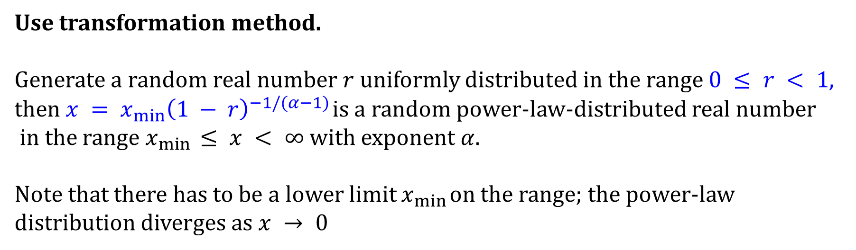
Histogram : Linear binning and Log binning
Task : Histogram of the set of random numbers which will have a power-law distribution with exponent α = 2.5.
Use transformation method.
Generate a random real number $r$ uniformly distributed in the range $0 ≤ r < 1$,
then $x = x_{min}{\left(1 − r\right)}^{−1/(α−1)}$is a random power-law-distributed real number
in the range $x_{min} ≤ x < ∞$with exponent $α$.
Note that there has to be a lower limit $x_{min}$ on the range; the power-law distribution diverges as $x → 0$

Slide 3
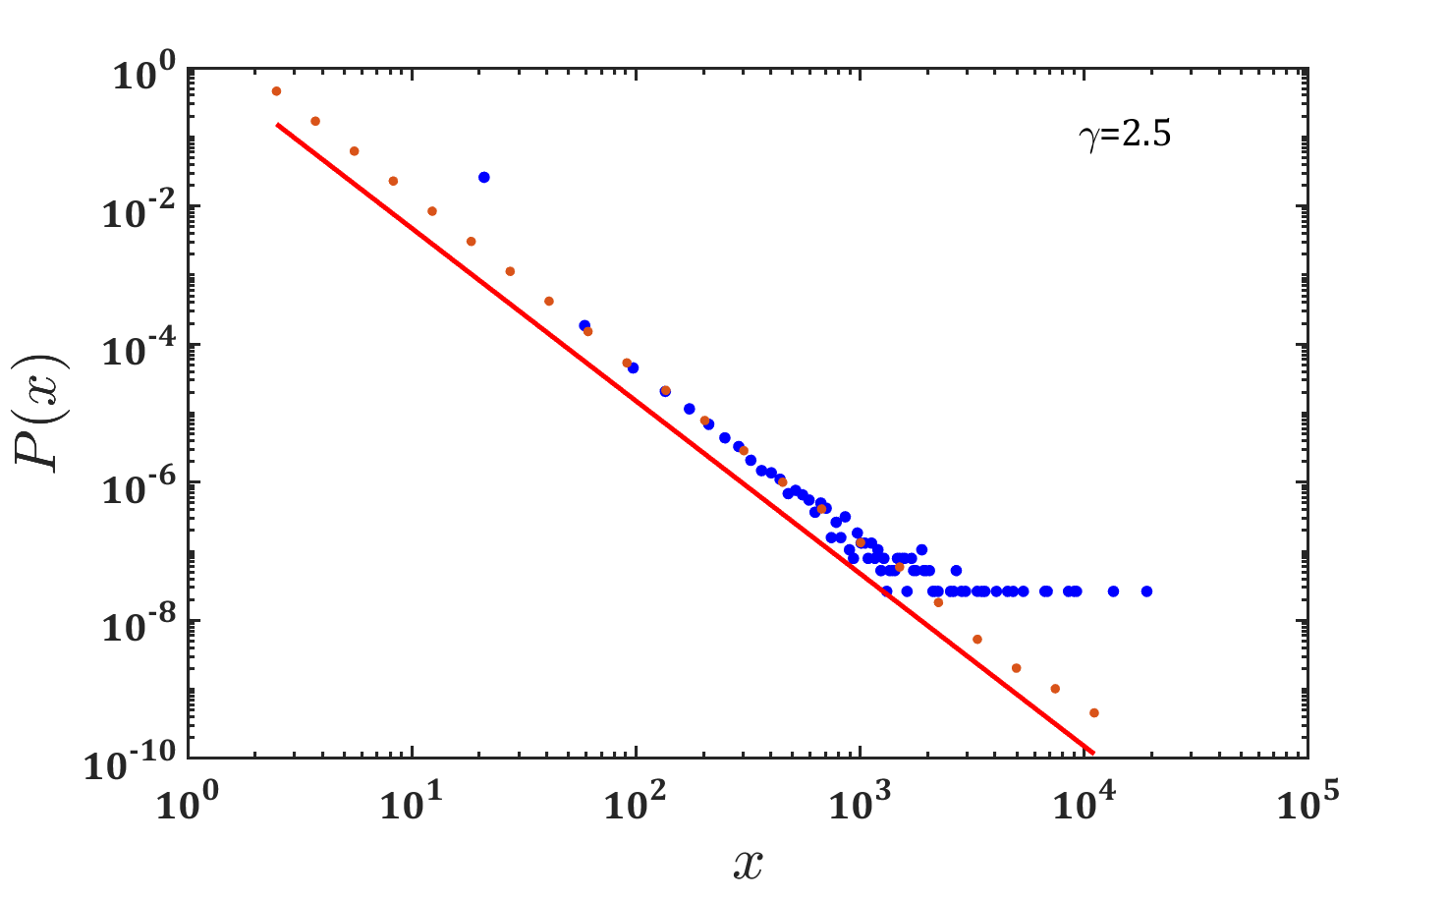
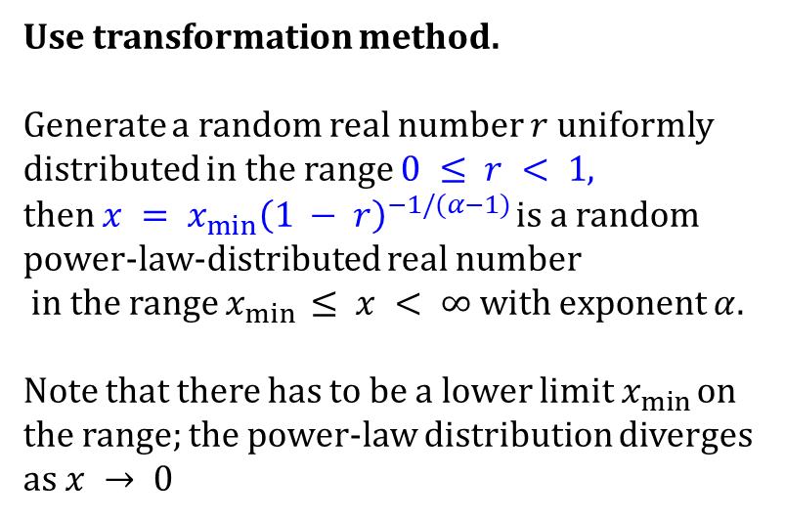
Histogram : Linear binning and Log binning
Task : Histogram of the set of random numbers which will have a power-law distribution with exponent α = 2.5.
Use transformation method.
Generate a random real number $r$ uniformly distributed in the range $0 ≤ r < 1$,
then $x = x_{min}{\left(1 − r\right)}^{−1/(α−1)}$is a random power-law-distributed real number
in the range $x_{min} ≤ x < ∞$with exponent $α$.
Note that there has to be a lower limit $x_{min}$ on the range; the power-law distribution diverges as $x → 0$

Slide 4
Histogram : Linear binning and Log binning
Task : Histogram of the set of random numbers which will have a power-law distribution with exponent α = 2.5.
To reveal the power-law form of the distribution it is better, as we have seen, to plot the histogram on logarithmic scales, and when we do this for the current data we see the characteristic straight-line form of the power-law distribution (blue dots).
However, the plot is in some respects not a very good one. In particular the right-hand end of the distribution is noisy because of sampling errors.
The power-law distribution dwindles in this region, meaning that each bin only has a few samples in it, if any. So the fractional fluctuations in the bin counts are large and this appears as a noisy curve on the plot.

Slide 5
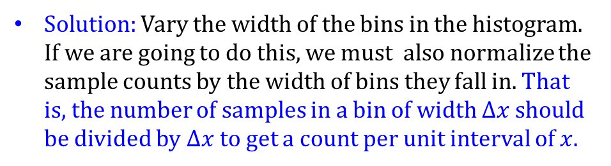
Histogram : Linear binning and Log binning
Task : Histogram of the set of random numbers which will have a power-law distribution with exponent α = 2.5.
Solution: Vary the width of the bins in the histogram. If we are going to do this, we must also normalize the sample counts by the width of bins they fall in. That is, the number of samples in a bin of width $Δx$ should be divided by $Δx$ to get a count per unit interval of $x$.
Then the normalized sample count becomes independent of bin width on average and we are free to vary the bin widths as we like.
The most common choice is to create bins such that each is a fixed multiple wider than the one before it. This is known as logarithmic binning.

Slide 7
Note that this expression becomes infinite if $α≤ 2.$ Power laws with such low values of have no finite mean. The distributions of sizes of solar flares and wars in are examples of such power laws.

Slide 9
If $α>3$, then the, second moment is finite and well-defined, taking the value

Slide 10
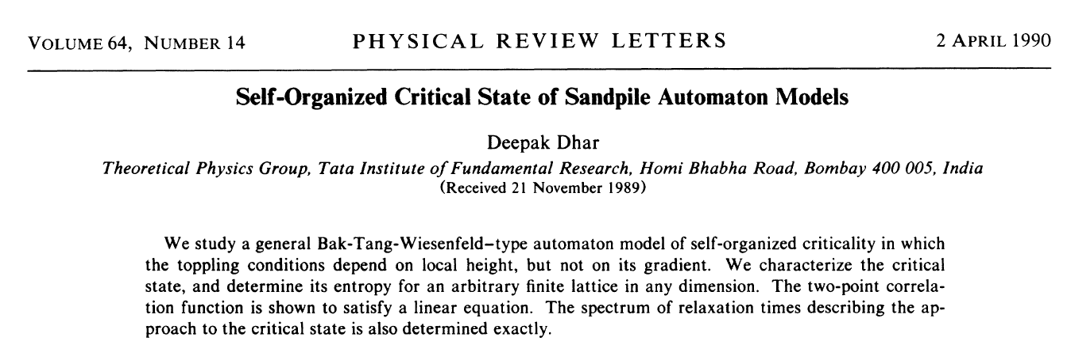

Slide 11
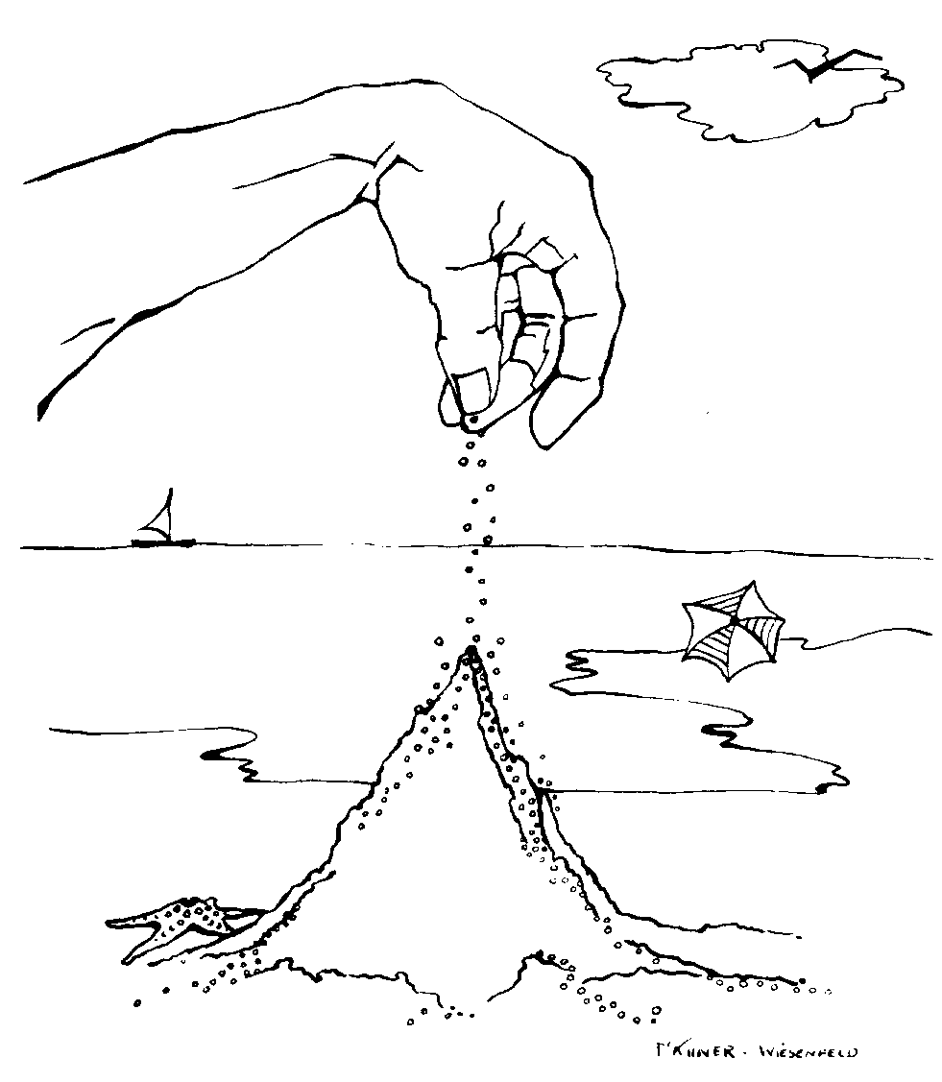
Avalanche Behavior
The sand pile builds . . .
grain . . .
by grain . . .
by grain . . .
by grain . . .
by grain . . .
by grain . . .
by grain . . .
by grain . . .
Building toward the critical state . . .
Where it avalanches
building
building
building
avalanche
avalanche
avalanche
Avalanche- a large mass of snow, ice, etc., detached from a mountain slope and sliding or falling suddenly downward.
Avalanche- anything like an avalanche in suddenness and overwhelming quantity: an avalanche of misfortunes; an avalanche of fan mail.

Slide 12
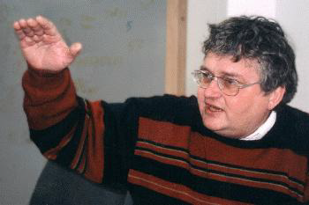
Self-Organized Criticality
Per Bak
1948-2002
“Complex behavior in nature reflects the tendency of large systems with many components to evolve into a poised, "critical" state, way out of balance, where minor disturbances may lead to events, called avalanches, of all sizes. Most of the changes take place through catastrophic events rather than by following a smooth gradual path. The evolution to this very delicate state occurs without design from any outside agent. The state is established solely because of the dynamical interactions among individual elements of the system: the critical state is self-organized. Self-organized criticality is so far the only known general mechanism to generate complexity.”

Slide 13
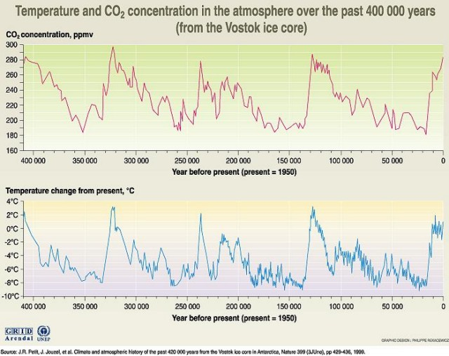
Now, imagine the sand supply follows a power law (or is fractal), with different numbers of grains falling at different times.
Avalanches will follow a power law distribution.
Earth Temp. curve over the past 400,000 years
http://atlas.gc.ca/maptexts/topic_texts/english/images/TemperatureCO2.jpg

Slide 14
Sandpile model
In most systems which exhibit critical phenomena, there exist adjustable parameters which have to be finely tuned in order for the system to reach the critical point. For example, in the Ising model, one needs to adjust both the temperature and the external magnetic field to close to their critical values.
If such a system is initially prepared such that the temperature and the external magnetic field are far from their critical values, the system will not show critical behavior even if other parameters are changed, or if the system is perturbed.
Cellular automata are mathematical models for systems in which simple components act together to form complicated and unpredictable patterns using a set of predefined rules. Two dimensional cellular automata are important to explain pattern formation in many physical systems, including crystal growth, turbulent patterns, and is greatly related to the topic of the sandpile. There are two neighborhoods that are often used in 2 dimensional CA models.

Slide 15
Sandpile model in 2-d Lattice

Slide 16
Sandpile model in 2-d Lattice
Step 1: Allow to make it stable starting from “unstable” states.
Step 2: Role of local perturbation
Claudius Gross

Slide 17
Sandpile model in 2-d Lattice
Loosely speaking one may identify the force $z_{i}$ with the slope of real-world sandpiles. But this analogy is not rigorous, as the slope of a real-world sandpile is a continuous variable.

Slide 18
Sandpile model in 2-d Lattice
Loosely speaking one may identify the force $z_{i}$ with the slope of real-world sandpiles. But this analogy is not rigorous, as the slope of a real-world sandpile is a continuous variable.
The slopes belonging to two neighboring cells should therefore be similar, whereas the values of $z_{i}$ and $z_{j}$ on two neighboring cells can differ by an arbitrary amount within the sandpile model.

Slide 19
Sandpile model in 2-d Lattice

Slide 20
Sandpile model in 2-d Lattice
Role of IC: Starting from identical stable IC, and perturb in several locations one by one.

Slide 21
SOC and Power Law

Slide 22
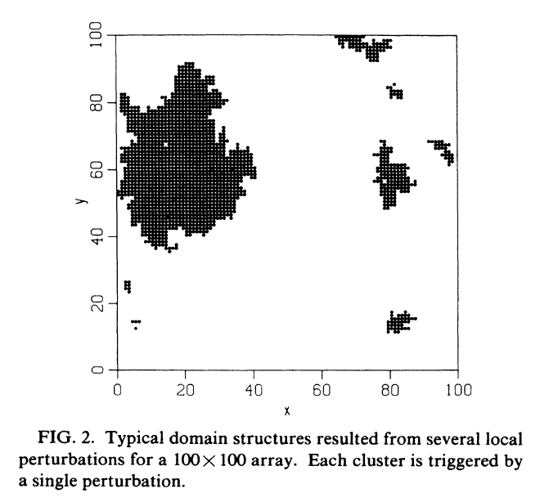
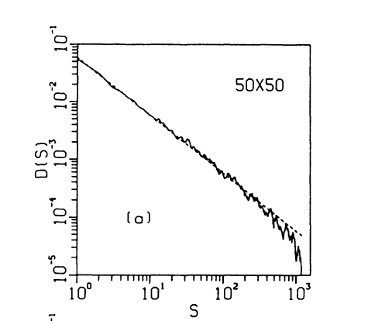
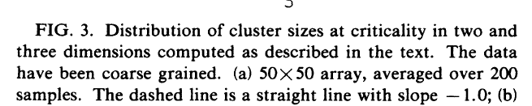
Sandpile model in 2-d Numerical model

Slide 23
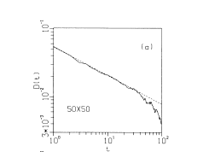

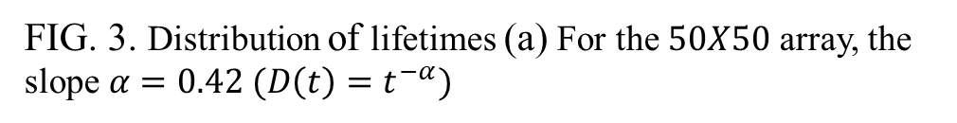
Sandpile model in 2-d Numerical model
FIG. 3. Distribution of lifetimes (a) For the $50X50$ array, the slope $α=0.42 (D\left(t\right)=t^{−α})$

Slide 24
SOC in Forest-Fire model

Slide 25
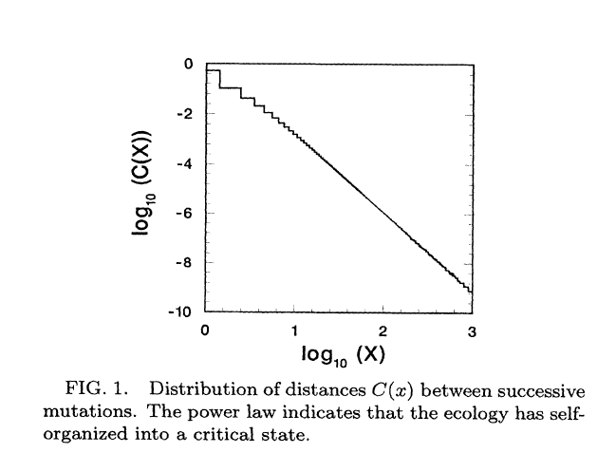
SOC in Model of Evolution

Slide 26

Examples of SOC
Life is a Self Organized Critical
phenomena

Slide 27
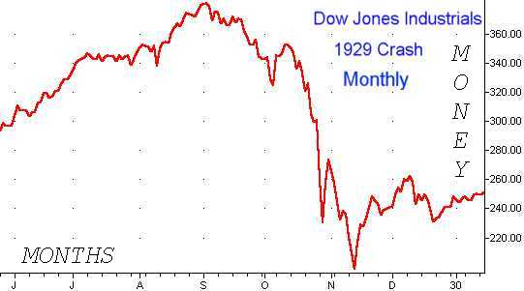
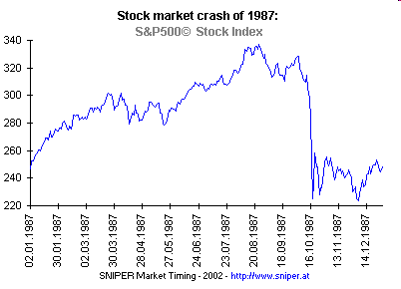
1929 stock market crash
1987 stock market crash

Slide 28
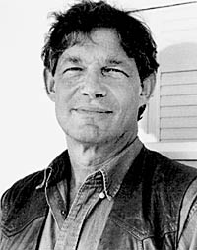
Stuart Kauffman
“The critical point is not, as Stuart Kauffman once described it, “a nice place to be.” So “survival of the fittest” does not imply evolution to a state where everybody is well off. On the contrary, individual species are barely able to hang on - like the grains of sand in the critical sand pile.”
Systems are always at the critical point, or if they are not at the critical point they are evolving toward the critical point.
That is, the common idea that systems evolve toward equilibrium is a misperception of reality.

Slide 29
Examples of SOC
Life is a Self Organized Critical
phenomena

